Slide 1
WAYNE
“SPOOKY”
MANOR
BY:
Krish Bagga
Sagnik Chakraborty
Pranshu Choubey

Slide 2

About our creation
What we have come up with for this Create-a-Thon is a showcasing of a haunted house setup in an interactive and immersive 3D environment using WebGL and Three.js.
Here you will be able to control an array of things, starting with the stationary light sources, coupled with the ability to control how the shadows react to the stationary and locomotive illuminating object (which then renders in real time in accordance to what the user wants). The spooky-ness is all under your control.

Slide 3
What we have used
The dependencies that were used in this project are:
Node.js
npm
JavaScript
WebGL
Three.js

Slide 4

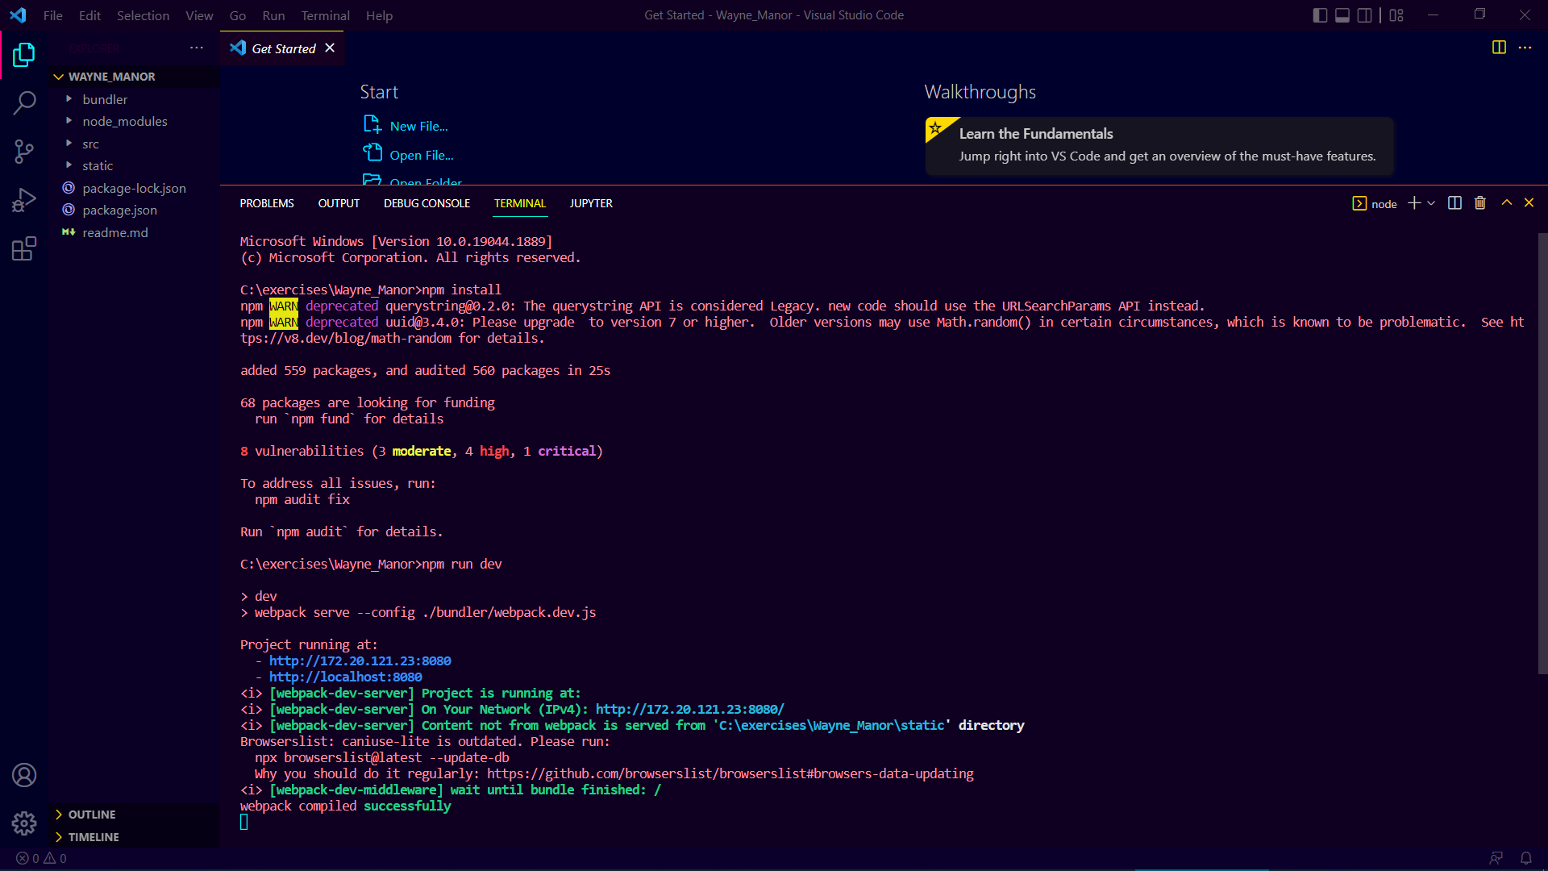
Running the Code in Powershell, the details of which can be found in the readme file

Slide 5
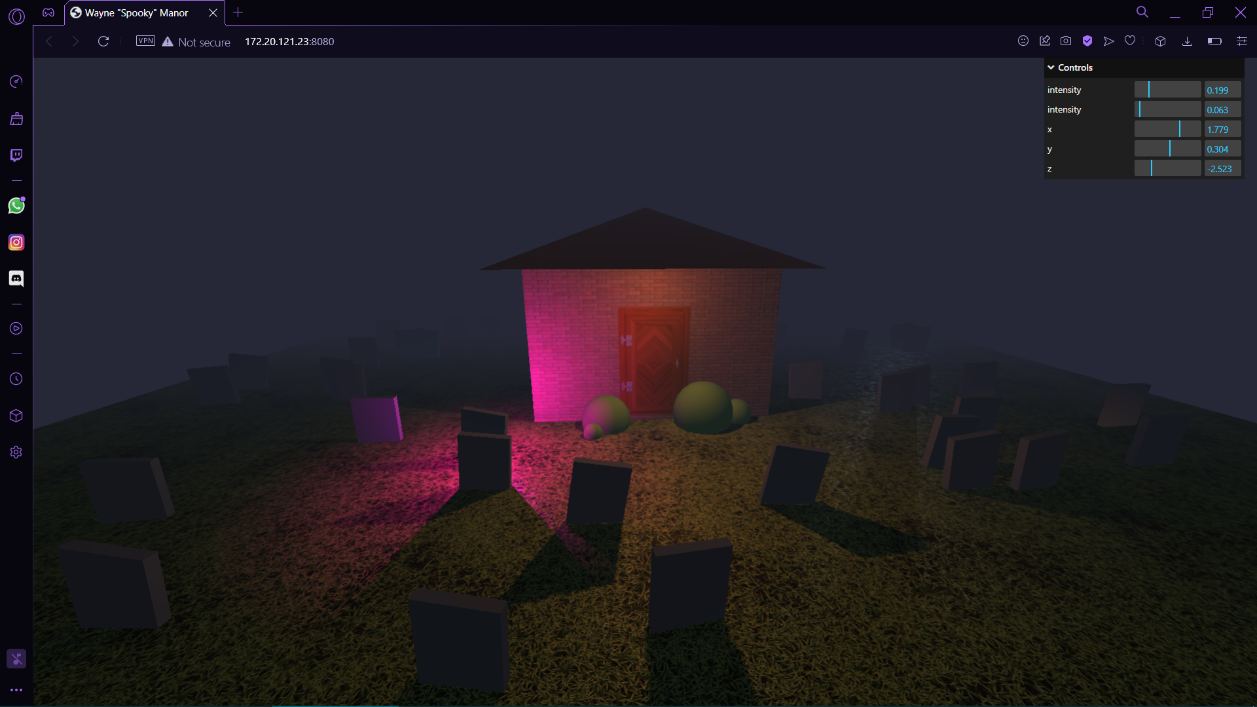
Our Manor in a couple of different perspective and light settings

Slide 6
